Slide 1
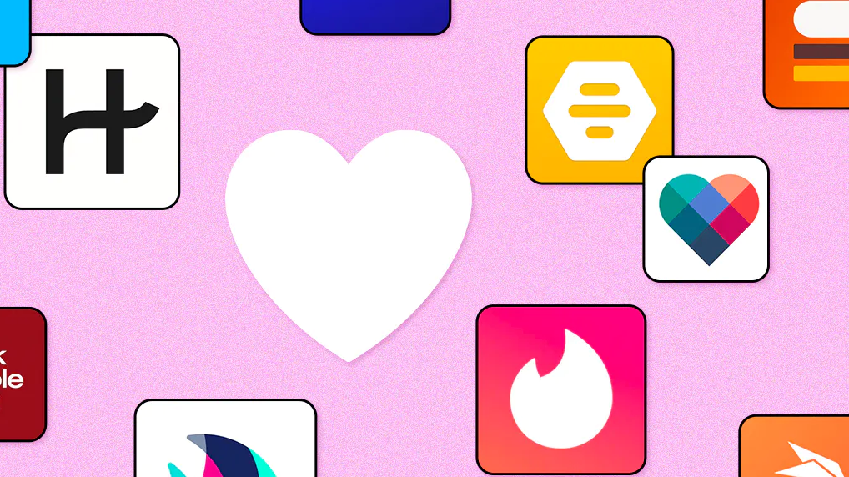
Exploratory Analysis of Dating Applications
Team Members: Ramiro Cervantes, Paola Moreno, Estela Perez

Slide 2
Background
Covid-19 pandemic affected the way people interacted with one another. Being that the pandemic forced everyone to isolate, not only by mandate, but also by fear of contracting the infection by human contact; people who were looking for courtship began accepting different ways to socialize. Many people turned to dating applications which became more commonly accepted platforms during the pandemic, where they socially connected without any fears of becoming infected.

Slide 3
Thesis
Our project will analyze the dating pool within the dating application OkCupid.
We will provide a summary of demographic data, including, gender, sexual orientation, zodiac sign and economic characteristics.
In addition, we will be comparing the ratings and “success” rates of the apps to determine their efficiency.
Lastly, we will be comparing the stock value of Match Group Inc (MTCH) and Bumble (BMBL) from 2019 – 2022.

Slide 4

What does the online dating pool look like?

Slide 5
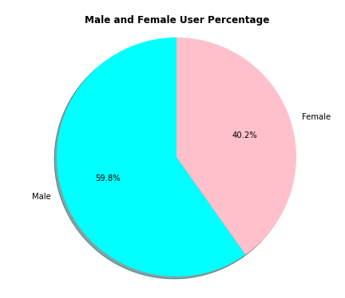
Gender
Out of OkCupid's most recent data of 59,946 total users

Slide 6
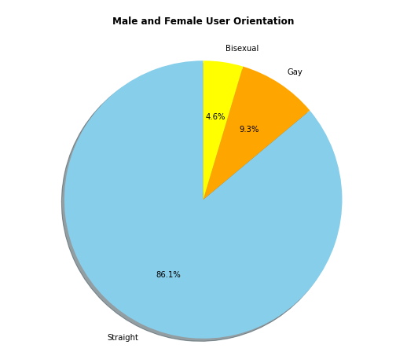
Sexual Orientation
Out of OkCupid's most recent data of 59,946 total users

Slide 7
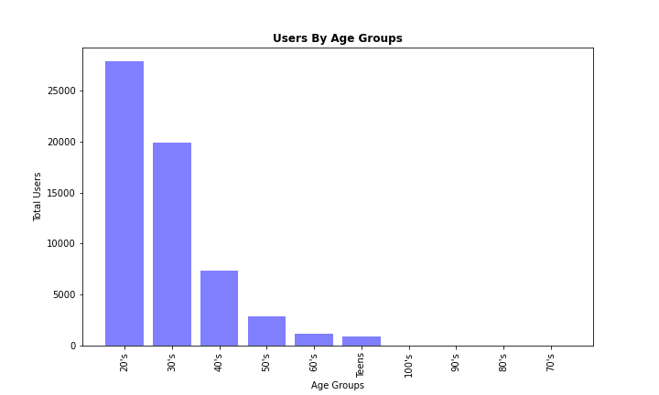
Age
Out of OkCupid's most recent data of 59,946 total users

Slide 8
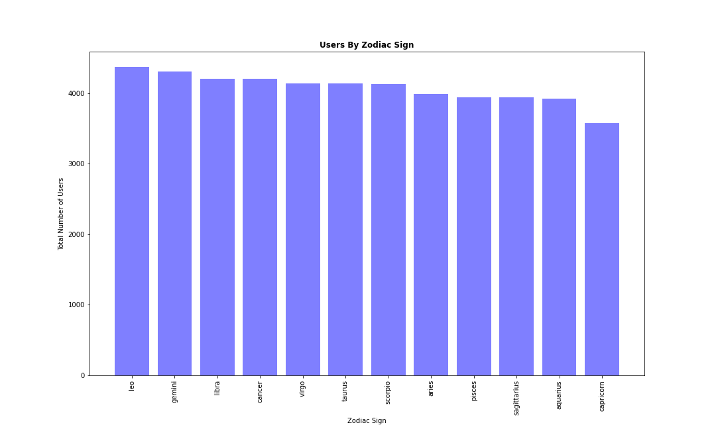
Zodiac Sign
Out of 59,946 total users only 48,890 shared their zodiac sign

Slide 9
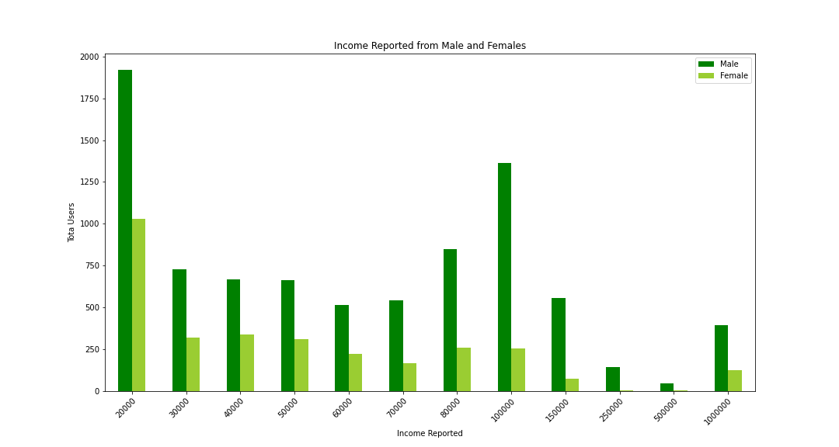
economic characteristics
Out of 35,829 male users only 8,391 responded to their income level
Out of 24,117 female users only 3,113 responded to their income level

Slide 10
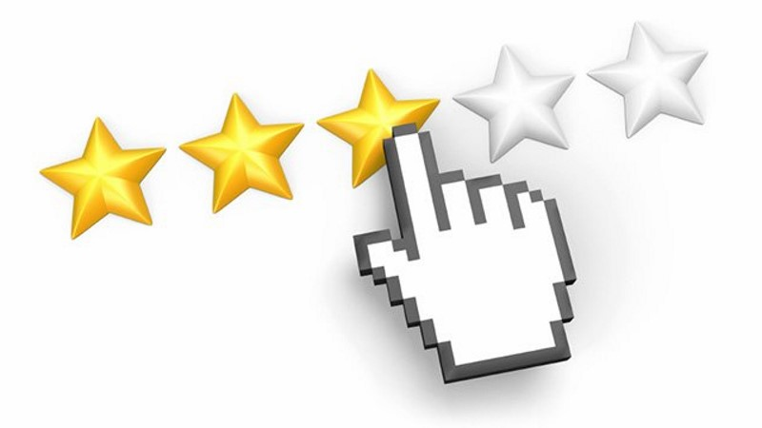
When comparing OkCupid, Tinder, and Hinge, which app is the best rated?

Slide 11
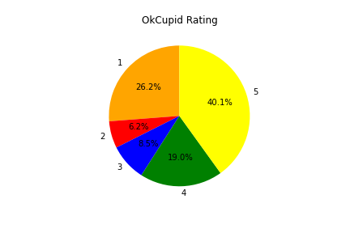
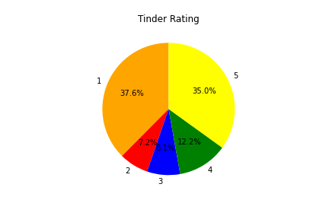
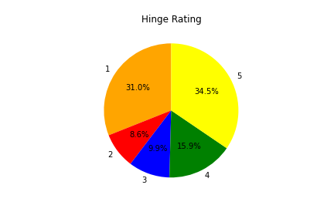
(1-5) Star ratings form the Google Play Store reviews as of May 2022

Slide 12
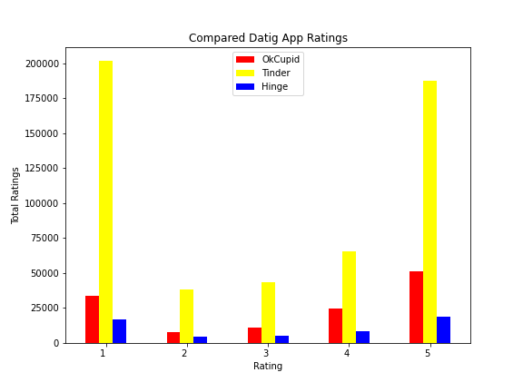
Comparison of all three total app reviews

Slide 13

How successful are these apps?

Slide 14
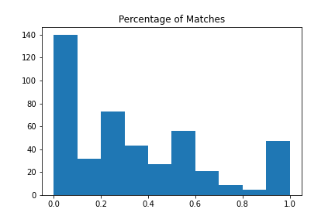
Match Rate
Users typically find a match 10% of the time or less.

Slide 15
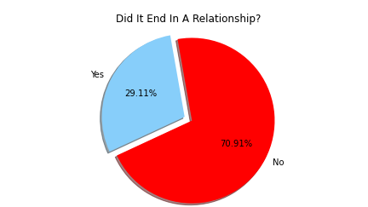
Success Rate
About 29% of users found a partner on a dating app.

Slide 16
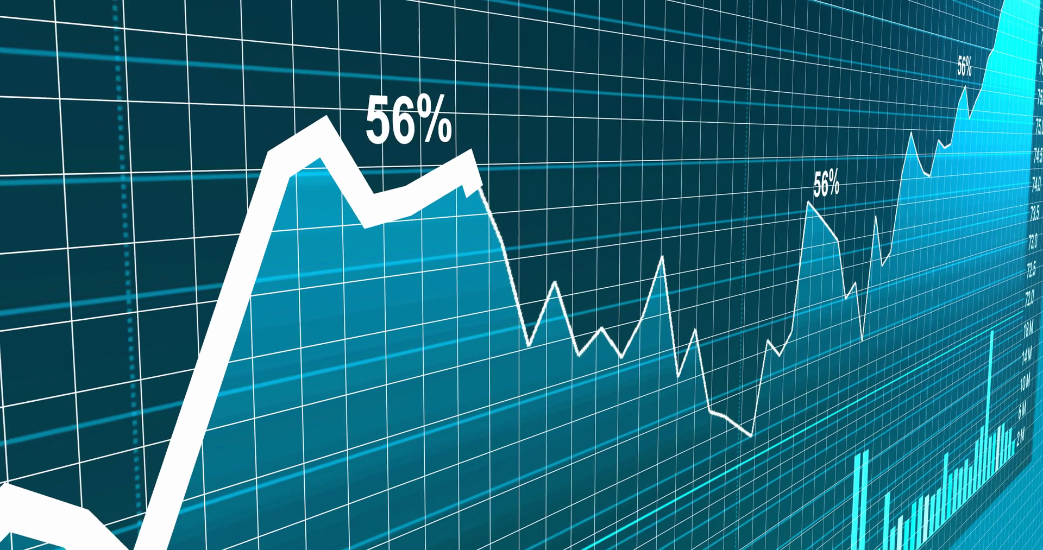
Has there been a change in the companies grows due to the pandemic?

Slide 17
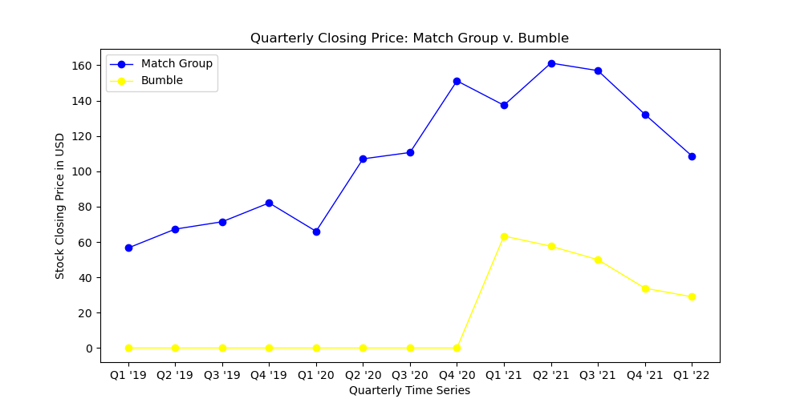
Quarterly Stocks Reports

Slide 18
Conclusion
Dating apps tends to appeal to a younger crowd and have a higher male percentage.
While Okcupid has a higher rating, Tinder is the still one of the most commonly used apps to date.
Chances of finding a long-term partner on a dating app are slim.
Dating app stocks grew in the height of the pandemic and have since decreased due to social distancing being lifted.

Slide 19

Limitations and difficulties

Slide 20

Limitations and difficulties
Use of secondary data limited our access to and control over the data collected.
Use of API proved difficult.
Git push/pull/merge.
Large CSV files.

Slide 21
Links
Datasets
OkCupid Profiles | Kaggle
Tinder Dating App - Google Play Store Review | Kaggle
Hinge Dating App - Google Play Store Review | Kaggle
OkCupid Dating App - Google Play Store Reviews | Kaggle
Tinder Millennial Match Rate | Kaggle
API
Free Stock APIs in JSON & Excel | Alpha Vantage

Slide 22
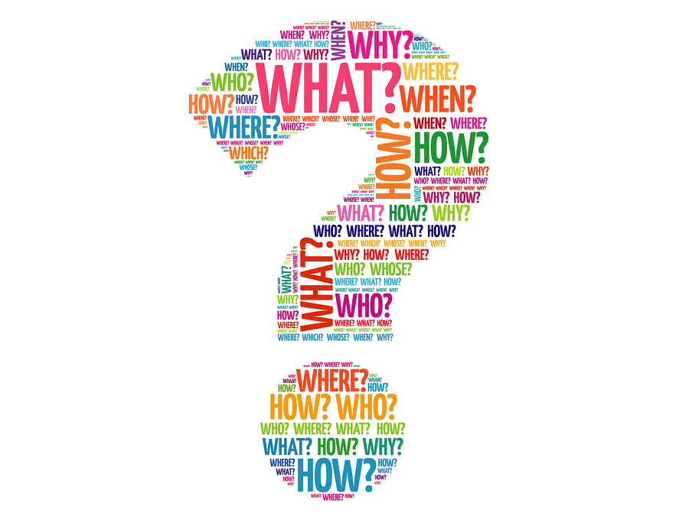
Questions and comments

